Slide 1
Group 3 Home Credit Default Detection
By Heber, Pankhuri, Hasitha, Meghana

Slide 2

OVERVIEW
Introduction of Home Credit
Business Problem
Objectives
Application Data & Features
Additional Datasets and Included Features
Conclusion: Business results, model performance
Notes:
Can we add this line on starting - “Home Credit: Bridging Financial Gaps”

Slide 3

BUSINESS PROBLEM
The key challenge for Home Credit is to maximize their loan approval process by accurately identifying customers with a high likelihood of repaying their loans on time. This will require developing an efficient and accurate predictive model that can assess the creditworthiness of potential borrowers.

Slide 4
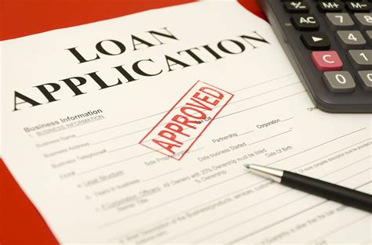
OBJECTIVE
Home Credit's aim is to leverage machine learning and data analysis to develop a robust predictive model that accurately identifies reliable borrowers, maximizing loan approvals and minimizing rejections. This will reduce the risk of defaults, improve profitability, and enhance overall customer satisfaction by increasing access to financial services.

Slide 5
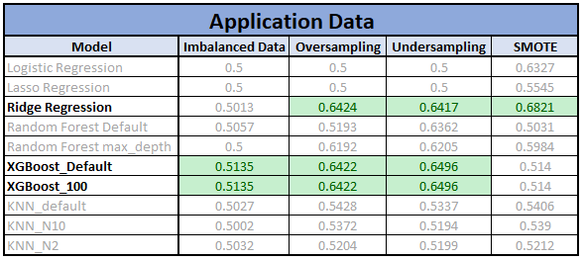
Notes:
In our analysis, many of the models had predicted accuracy above 50%. Three models in particular did exceptionally, well including Ridge regression, and XGBoost models.

Slide 6
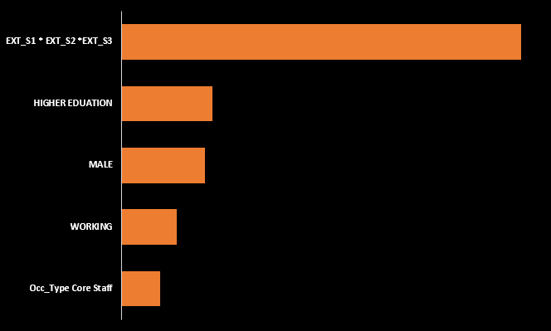
Feature Importance
(XGBoost using Undersampling on Application Data)

Slide 7

Added Data Features
Total Number of Loans
Number of Active Loans
Total_Credit_Amount
Number of Previous Applications

Slide 8
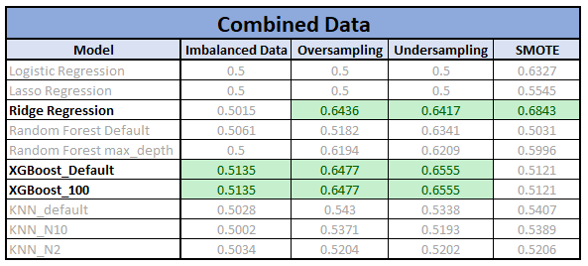

Slide 9
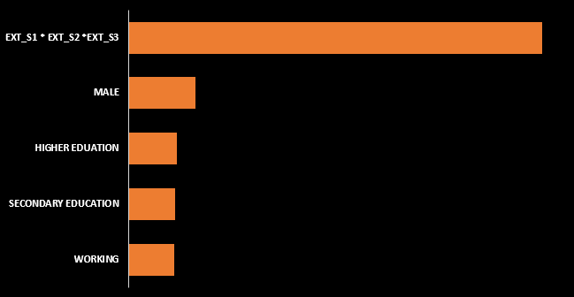
Feature Importance
(XGBoost using Undersampling on Combined Data)

Slide 10
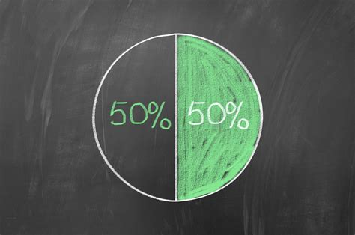
Majority Class Performance
Notes:
In order to determine model performance, we first needed to establish a performance baseline. For our analysis we used the majority class of the Target variable as our baseline.
Home Credit’s majority class was to classify all customers as preferred customers, meaning they are likely to pay back the loan.
When ran this model against new data, in the online Kaggle competition. The accuracy score we received was 50%.
This was our models baseline to beat.

Slide 11
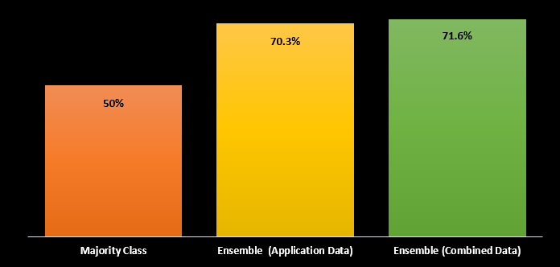
Kaggle Performance
Notes:
When running the new models on the same new data in the Kaggle competition we received the following score. The majority class was 50%, the Ensemble model trained solely on the application data was 70.3, and the Ensemble model trained on the combined dataset was 71.6%. Now, how might this look for Home Credit if they started implementing these models in their loan application screening process?

Slide 12
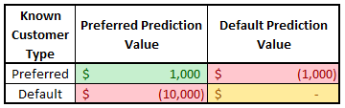
Simulated Costs & Benefits
Notes:
We simulated an Cost, Benefit analysis on our model. We applied the following dollar values to each outcome generated from the model.
If we could correctly identify preferred customer (those likely to repay their loans) the company would gain $1,000.
If we miss identified a preferred customer and did not issue them a loan, we would lose that $1,000.
If we correctly identified a customer likely to default, Home Credit would have no impact as we would not issue them credit.
However, if we miss classified a customer likely to default, and issued them a loan, Home Credit would loose $10,000, because the customer is not likely to repay the loan.

Slide 13
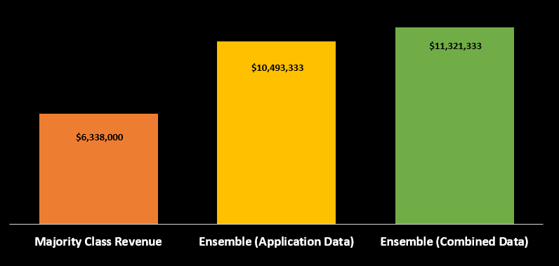
Estimated Model Revenue
Notes:
The results of the simulation were the majority class would generate $6.3M worth of revenue, the Ensemble model trained on Application data would generate just under $10.5M, and the ensemble model trained on the combined data would generate a total of $11.3M worth of revenue for HomeCredit.
We would strongly recommend, HomeCredit start implementing, the Ensemble model into their current credit screening process. By doing so, company revenue will increase and HomeCredit will be able to continue its missing to provide access to financial credit to those with limited access to credit history.

Slide 14
Questions

